Slide 1

Data Governance @ SneakerPark

Slide 2
Background
SneakerPark is an online shoe reseller that allows people to buy and sell used and new shoes. Buyers can bid for shoes or buy them outright, and sellers can set a price or sell to the highest bidder.
Each buyer and seller must have an active account in order to sell, bid, or purchase sneakers using SneakerPark’s website.
SneakerPark authenticates the shoes before shipping them to the buyer, so before listing an item, the seller must ship it to SneakerPark’s warehouse. Upon receipt, SneakerPark assigns an item number to each pair of sneakers and notifies the seller that they are now free to list their item. If the item is not listed within 45 days, SneakerPark returns it to the seller and sends an invoice to the seller for the shipping cost.
If the item is found to be inauthentic or in an unacceptable condition, it is also returned back to the seller in a similar fashion.
When the item sells, the buyer’s account is credited with the purchase price minus the SneakerPark service fee and shipping fees to deliver the item to the buyer.
Currently, SneakerPark only supports sales within the United States.

Slide 3
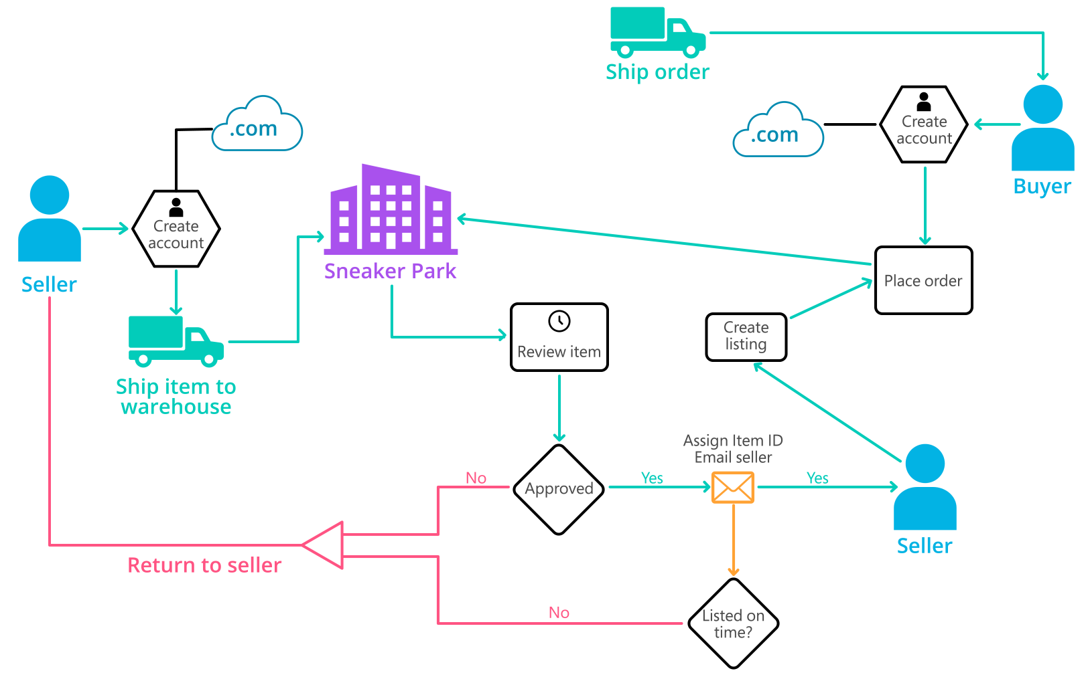
Background (cont’d)
Below is a diagram for some of SneakerPark's business processes.

Slide 4
Step 1
Enterprise Data Catalog Part 1: Enterprise Data Model

Slide 5
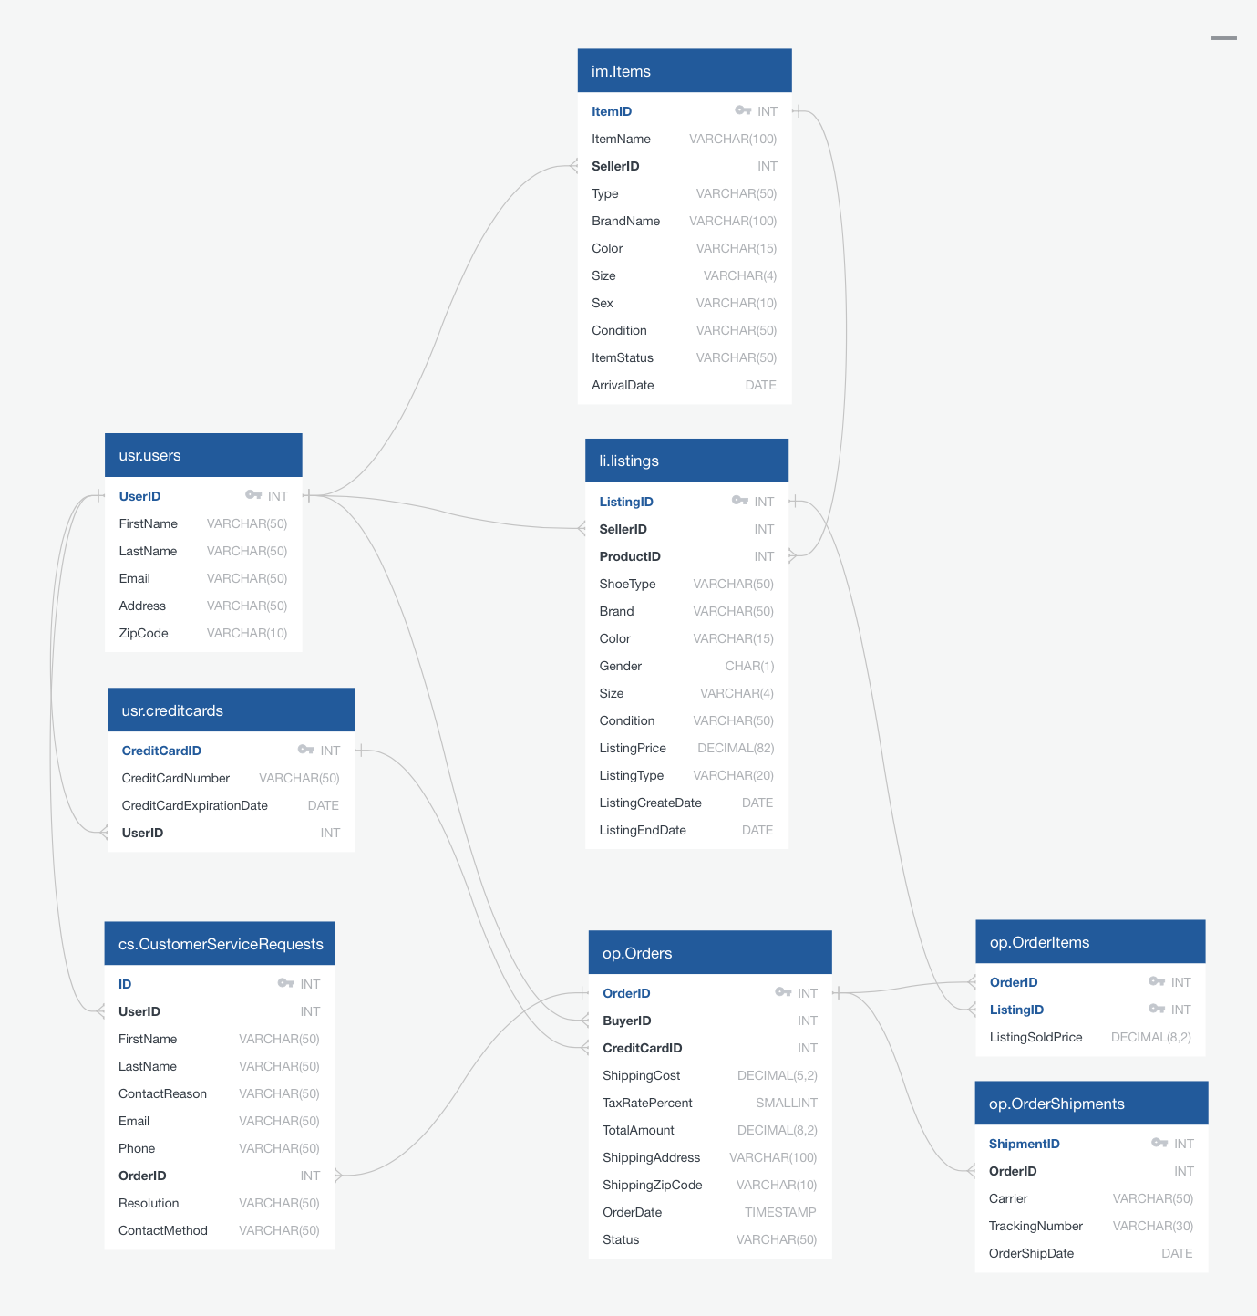
The Enterprise Data Model provides a holistic view of SneakerPark’s data systems and the organization's important entities and relationships.

Slide 6
Step 2
Enterprise Data Catalog Part 2: Metadata

Slide 7
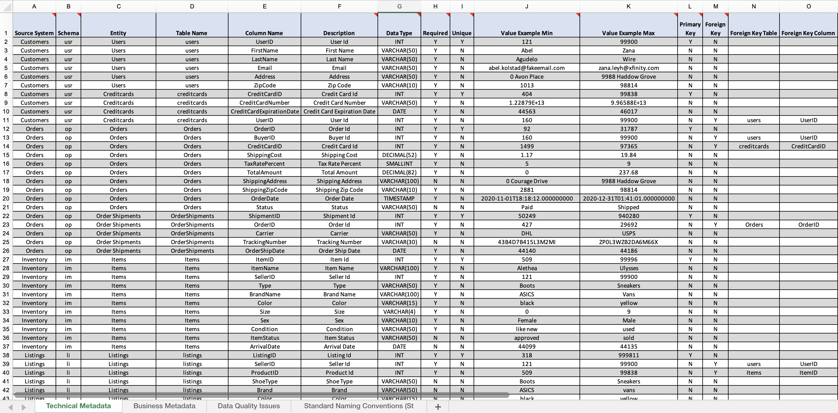
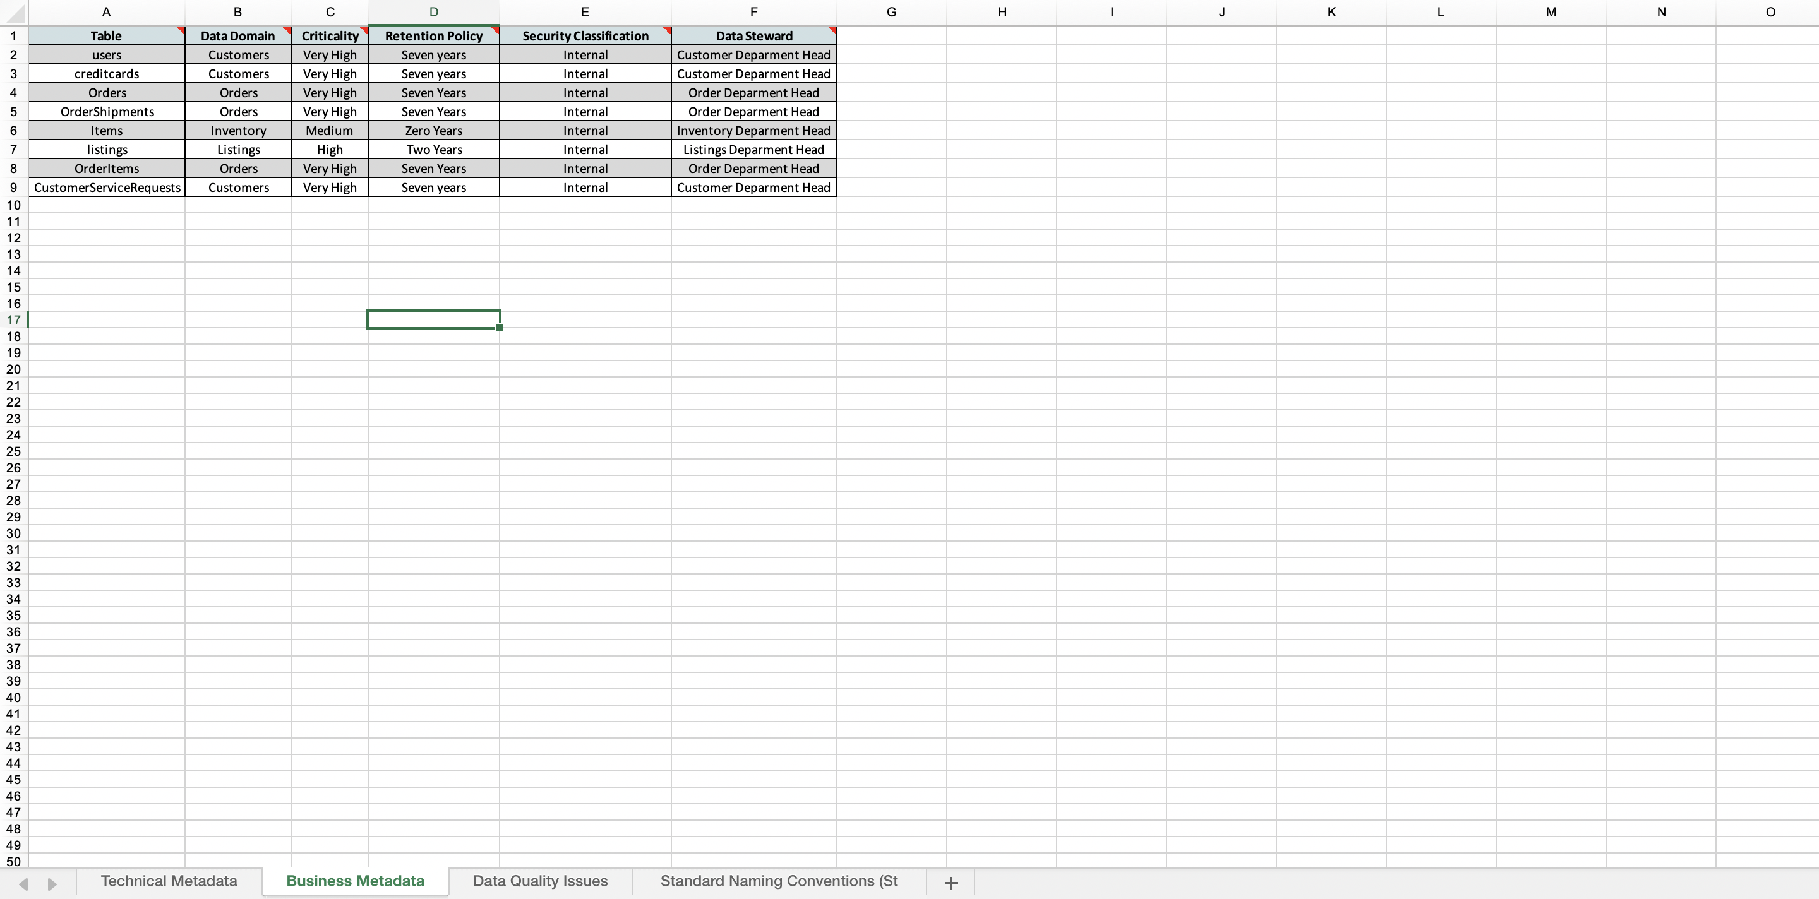
Technical Metadata
Business Metadata

Slide 8
Step 3
Data Quality
Part 1: Profiling and Cleansing

Slide 9
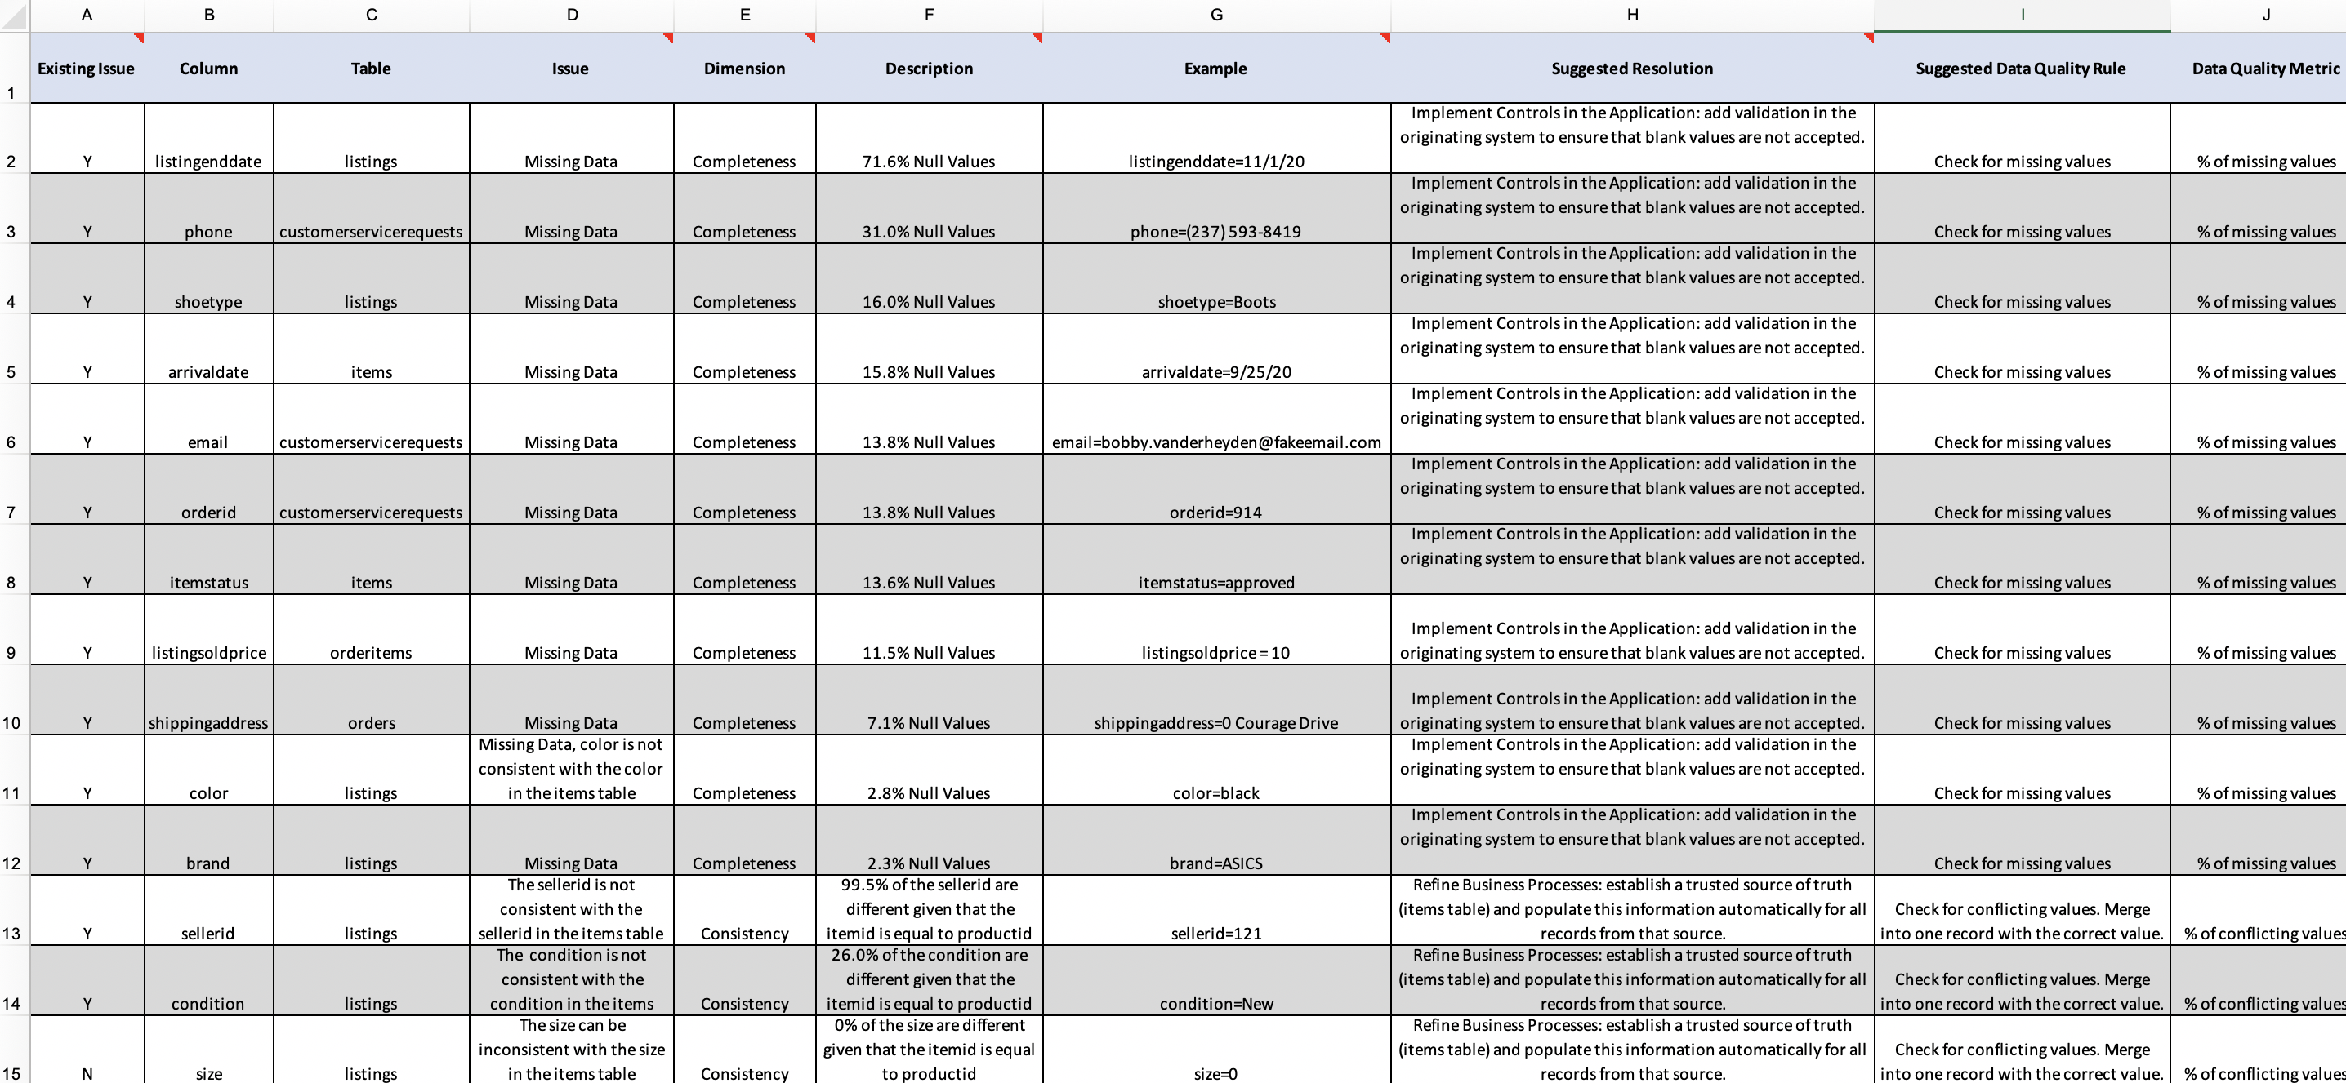
Data quality issues

Slide 10
Step 4
Data Quality
Part 2: Monitoring

Slide 11
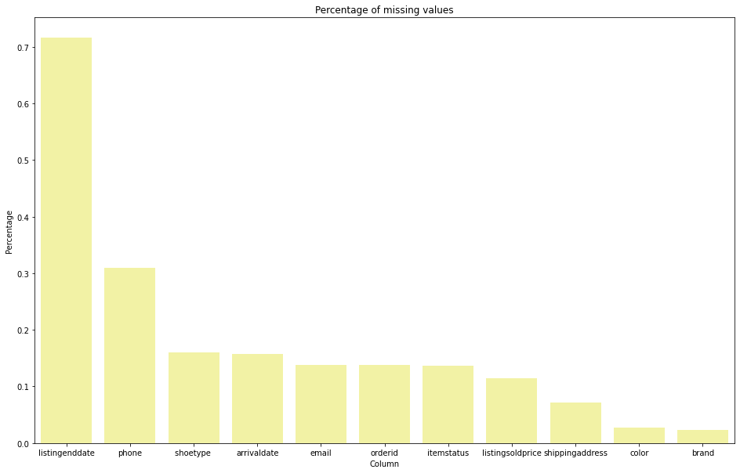
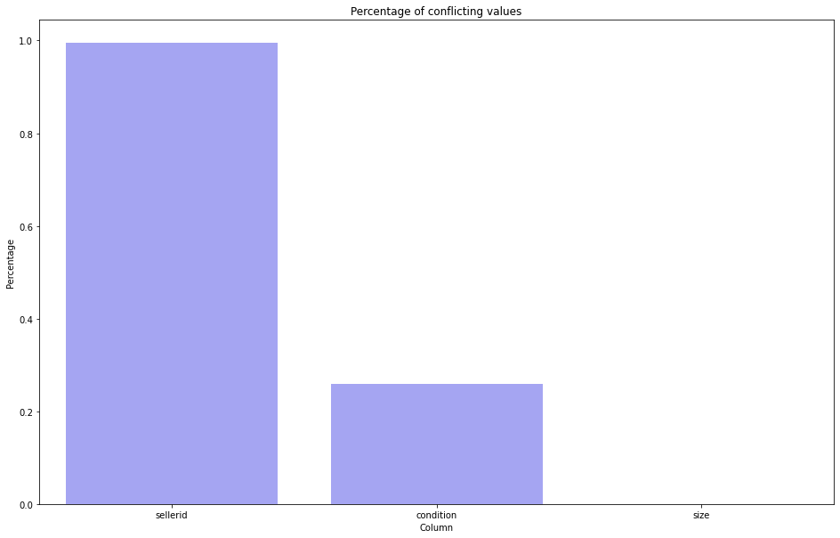
Data quality monitoring dashboard

Slide 12
Step 5
Master Data Management
Part 1: MDM Architecture

Slide 13
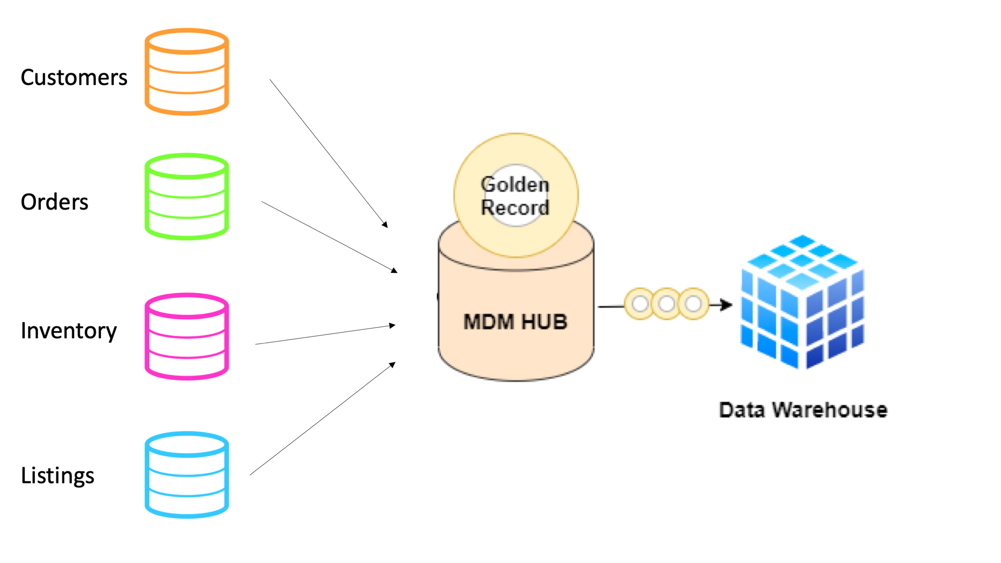
Proposed MDM implementation architecture
I've chosen to go with Consolidated style of architecture. SneakePark has a number of disparate systems that makes it difficult to trace the same item and seller across different systems. The scenario description states that the company plans to build out an Enterprise Data Warehouse solution to replace the existing legacy data warehouse, MS Access databases, and excel reports, which makes me think there are analytical needs. For that reason, I believe consolidating data from all these systems into a central MDM Hub that can feed merged, cleansed, and verified golden records to data warehouses and reports is the best solution here.

Slide 14
Step 6
Master Data Management
Part 2: Master Record

Slide 15
Matching rules that will be used by the SneakerPark's MDM Hub to match item and customer entities between the company's different systems.
For Items:
Match item data on itemid.
Match item data on productid.
For Customers:
Match customer data on userid.
Match customer data on sellerid.
Match customer data on creditcardid.

Slide 16
Step 7
Data Governance:
Roles and Responsibilities

Slide 17
Data governance roles and responsibilities
Data stewards are subject matter experts on the data.
They establish and maintain the enterprise data model and data catalog.
They are responsible for data profiling, data quality Remediation and data quality monitoring.
They play a critical role in MDM implementation. They define match rules for golden record creation. They review the match results from the automated match process to make sure the result is accurate. They can approve or reject the golden records created by the automated matching algorithms. They can also override match results by manually updating the golden records created by the automated matching algorithms. Data stewards review the rejected records and either identify additional match rules or manually create golden records for these rejections. Finally, they also manually create golden records.
Jake and Jessica have the skills required to fulfill the responsibilities of the data stewards.

